Slide 1
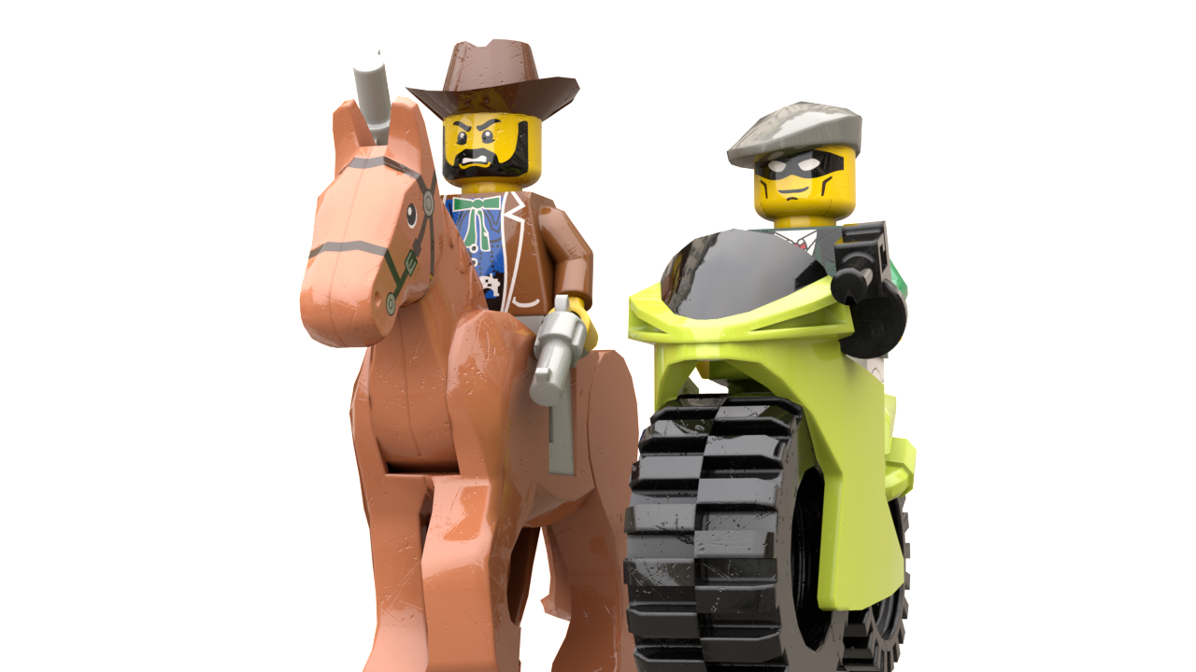
Security
Parallel
Protocols

Slide 2
What was the world like in 1995?
1995: Bill Clinton, first term, family man
Top Shows: Seinfeld, Home Improvement
CDs had recently overtaken Cassettes in sales
DVDs invented but unavailable
Steve Jobs worked for NeXT, Inc.
US population 265M (~330M today, 80%)
World population 5.7B (~7.7B today, 75%)

Slide 3
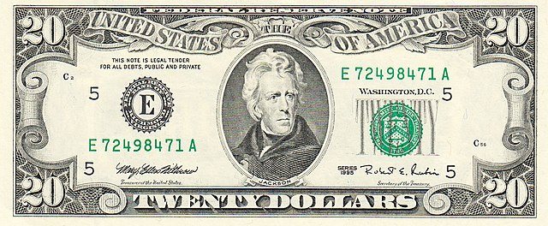
What the world didn’t have in 1995
No one had heard of Harry Potter (even in England). (1997)
Cable news only meant CNN. No Fox or NBC. (1996)
President who? Barack Obama was an attorney in Chicago.
GOAT? LeBron James was in his rookie year—as a fifth grader.
What is a Pre/Post trilogy? There were only three Star Wars Movies.
MCU? Howard the Duck was the only Marvel-based film to hit Theaters by 1995.
No global warming concerns, just the hole in the ozone.
All money was green.
Series 1995 $20, Public Domain,
https://commons.wikimedia.org/
w/index.php?curid=1669460

Slide 4
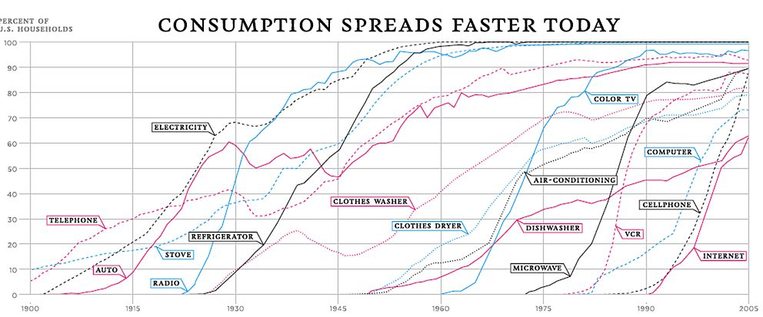
1995
Attributed to visualizingeconomics.com

Slide 5
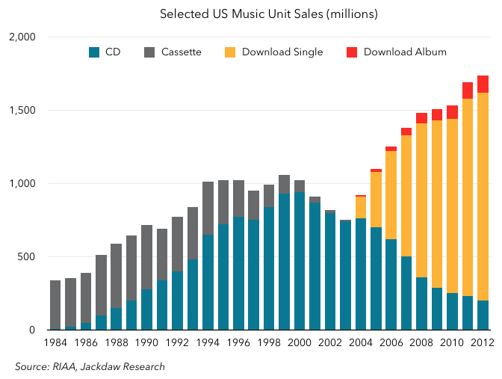
1995
From https://techpinions.com/the-cd-smartphone-analogy/47027

Slide 6
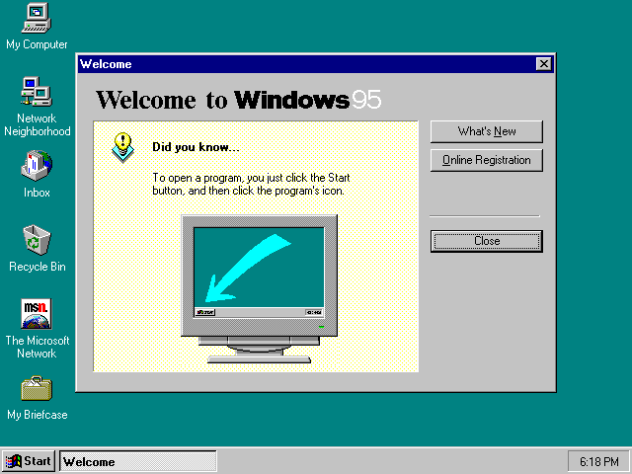
1995: Microsoft Windows 95
Used with permission from Microsoft, see
https://en.wikipedia.org/wiki/File:Windows_95_at_first_run.png

Slide 7
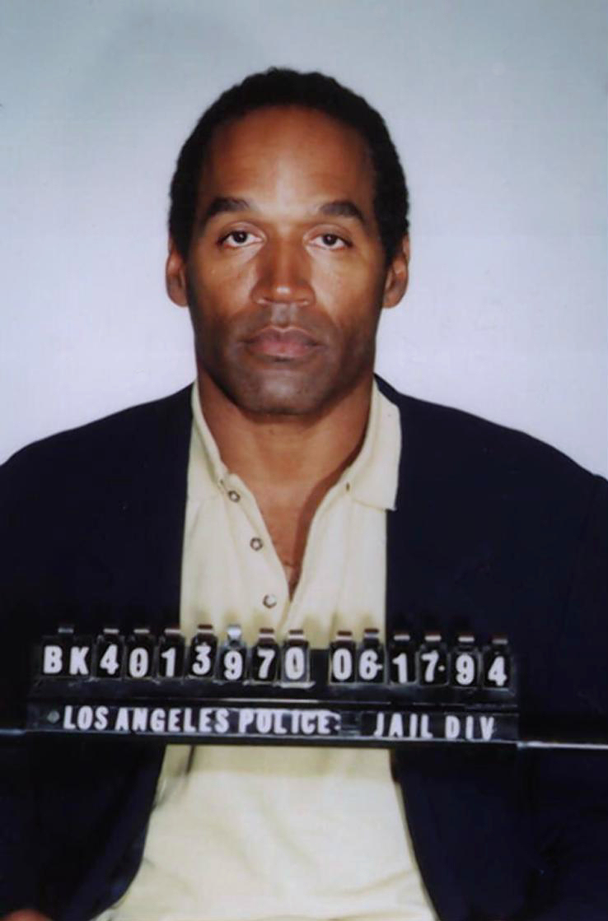
1995
The nightly news (yes, you could only watch the news at a certain time—you could read the newspaper any time you wanted after it came in the morning) started with the same story every night—the “trial of the century.”
By Peter K. Levy from New York, NY, United States - George Sand, Public Domain, https://commons.wikimedia.org/w/index.php?curid=61075827

Slide 8
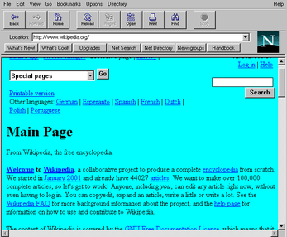
1995: Netscape Navigator
Copyrighted Image. For fair use rationale, see:
https://en.wikipedia.org/wiki/File:Navigator_1-22.png

Slide 9
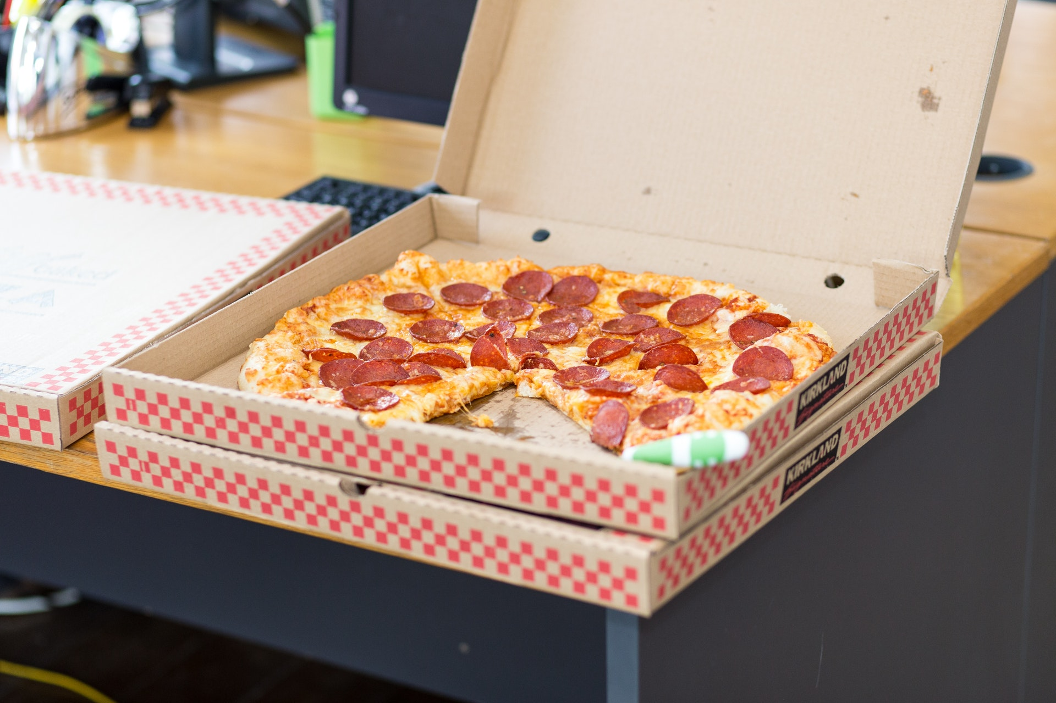
Pizza Comes in a Box
Separation
Boxes tell us where each pizza starts and ends
We Don’t Eat the Box
It’s disgusting.
We Eat Pizza
But without the box, the pizzas would be disgusting.
Details
Boxes tell us about the pizza

Slide 10
Protocols are like [Pizza] Boxes
Version Info
What is this?
<!DOCTYPE html>
<html>
<head>
<meta charset='utf-8'>
<meta http-equiv='X-UA-Compatible' content='IE=edge'>
<title>Page Title</title>
<meta name='viewport' content='width=device-width, initial-scale=1'>
</head>
<body>
This is the part you can see.
</body>
</html>
Meta-Data
Information about the content.
Start
Where do we begin?
End
Body
Crucial! Where do we stop?
The part the user actually “consumes.”
http://www.evolutionoftheweb.com/

Slide 11
HTTP Protocol
HTTP Request
Request Line <METHOD> <URL> <VERSION> GET /index.html HTTP/1.1
Some Methods (verbs): Traditional “browser” methods: GET POST (Request has a body) HEAD (no body) API-Related (growing in popularity) PUT DELETE PATCH HTTP Versions: 1.0 – Non-Persistent 1.1 – Persistent 2.0 – Major Update
Header Lines <HEADER NAME>: <VALUE> Host: www.example.com
Response Line <VERSION> <STATUS > <PHRASE> HTTP/1.1 200 OK
Common Status Codes: 2xxx: Success 200 – OK 3xx: Redirect 301 – Moved Permanently 4xx: Client Errors 400 – Bad Request (Bad API Call) 403 – Unauthorized (Bad API Call) 404 – Not Found 5xx: Server Errors 500 – Internal Server Error
Request Line
Header Line
…
Header Line
Blank Line
[Optional] Body
HTTP Response
Response Line
Header Line
…
Header Line
Blank Line
[Optional] Body

Slide 12
HTTP Protocol—Browser Example
Your browser makes a lot of requests to render a page
Server
Server Opens a Socket
Browser
Server Waits for a Connection
HTTP Request
HTTP Response
Client Parses Response
Client requests additional resources based on the body of the response. These could be images, .css, or .js files.
Server receives multiple requests almost simultaneously. This is where threading comes into play.
Client either requests additional resources or has enough to display a page.

Slide 13
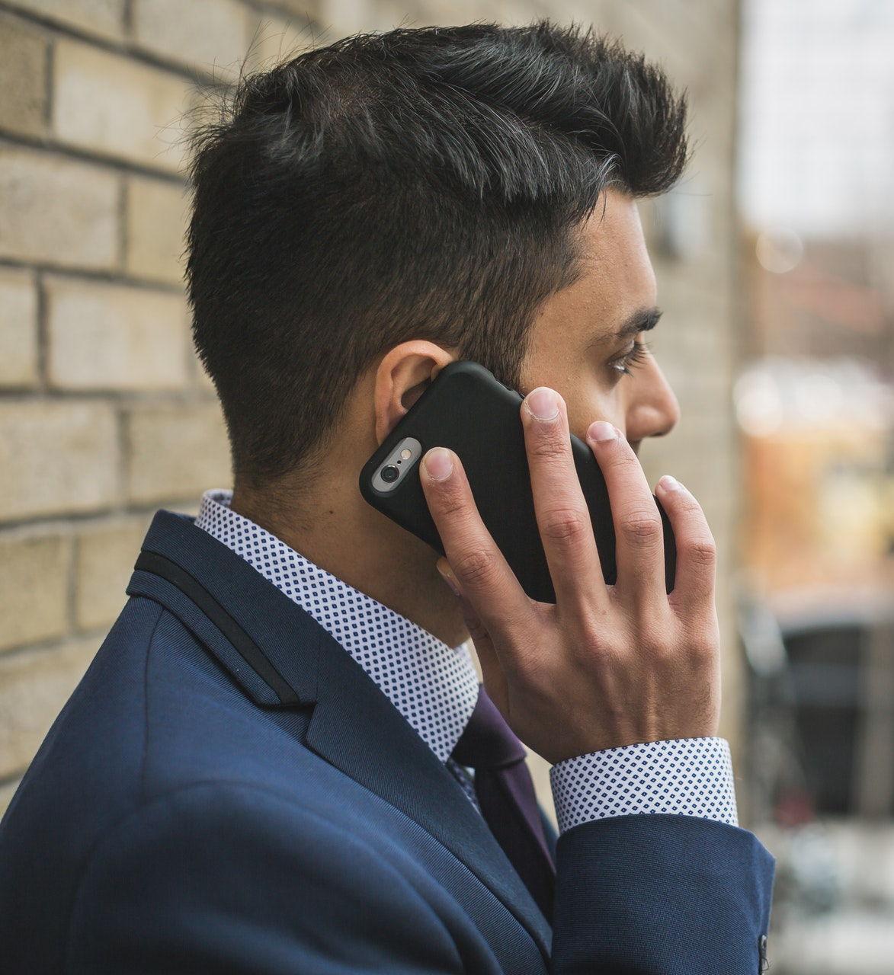
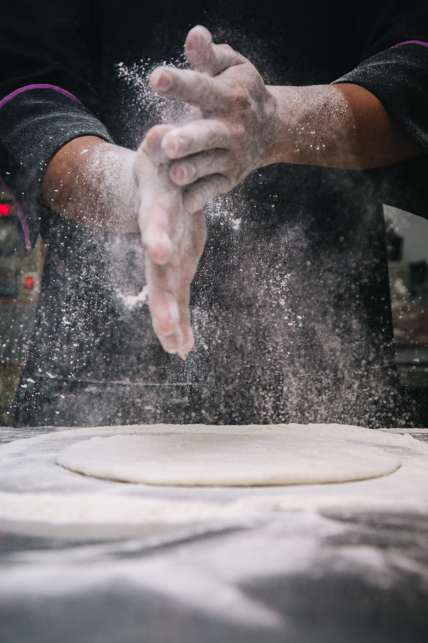




HTTP Protocol 1.0 vs 1.1
HTTP 1.0
Or The Story of the Annoying Pizza Orderer
HTTP 1.1
Non-persistent.
You can only make one request at a time.
Most notably, maintains a persistent connection.
Hello, I’d like to order a cheese pizza.
Goodbye.
Hello, I’d like to order a cheese pizza,
a pepperoni pizza,
and a supreme pizza.
Goodbye.
Hello, I’d like to order a pepperoni pizza.
Goodbye.
Hello, I’d like to order a supreme pizza.
Goodbye.
Photos courtesy Pexels.com and are subject to the pexels license, https://www.pexels.com/license/

Slide 14
Monolithic v. Microservice
Or How to partition the backend?
DB
DB
DB (MySQL)
Code (PHP)
Server (Apache)
OS (Linux)
NIC
Code
Server
OS
NIC
Code
Server
OS
NIC
Code
Server
OS
NIC
Monolithic
Code
Server
OS
NIC
Microservice

Slide 15
When is a Server not a Server?
Or When is a server not a server?
HTTP Request
TCP
IP
HTTP Request
TCP
IP
Server
Server
Browser
OS
OS
OS
NIC
2
NIC
1
NIC
3
4
API Server
JSON
HTTP Response
TCP
IP
Web Server/
API Client
HTML
HTTP Response
TCP
IP
Client
This is a archetype for server routing packets on the internet.

Slide 16


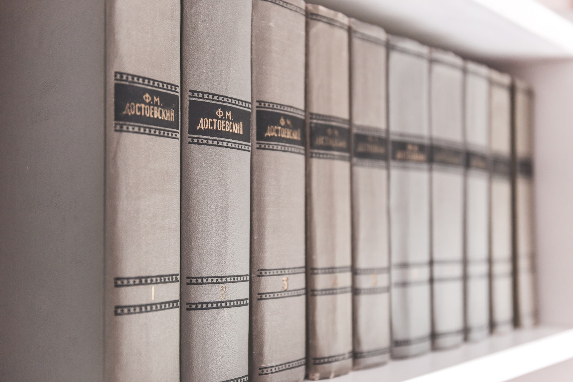
3 Main Types of APIs
Or visiting the library before the internet?
Public APIs
Key-Based APIs
OAuth(2) APIs
My kids want fun books for the summer, so I check out a lot of books using their library cards.
My daughter asks me a question, so I go to the reference section of the library to find the answer in an encyclopedia.
My son wants information for a book report, so I go to the library and check out books using my library card.

Slide 17
3 Main Types of APIs
Public APIs
Key-Based APIs
OAuth(2) APIs
Require a server to protect key and to do key exchange
May not require a server.
Require a server to protect API key.
Server must throttle/ban based on
IP address.
Server can throttle/ban based on API key.
Server can throttle/ban based on key.
Code author cannot publicly commit API key
Code author cannot publicly commit Oauth key
Code author has nothing to hide
No setup required to call API endpoint
Code author must register/pay for an API key.
Code author must register/pay for an OAuth key.
API can be dynamic. API caller can represent up to one user.
API can be dynamic. Code by represent many different users
API is static

Slide 18
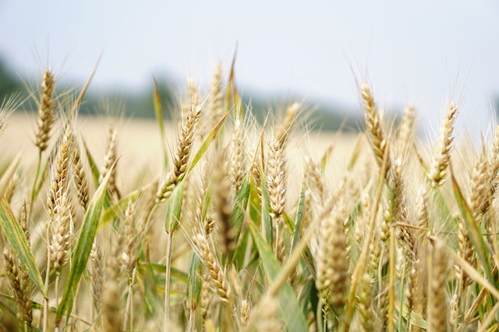

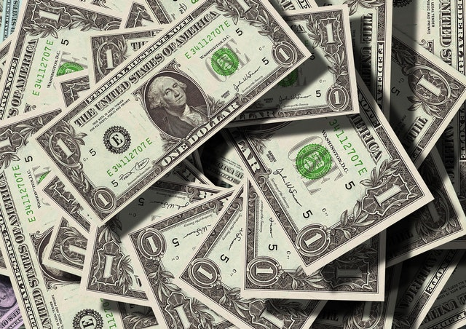
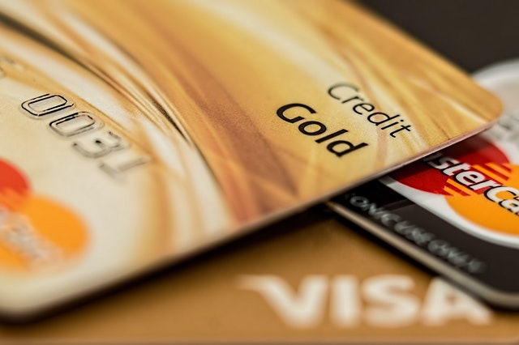
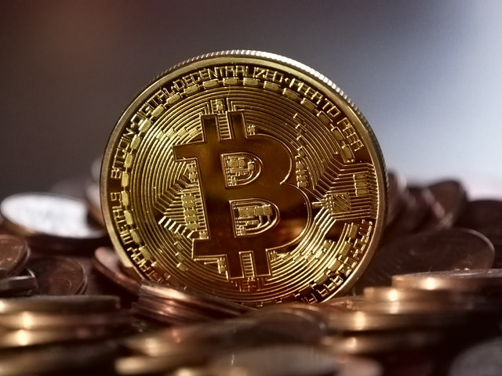
Kinds of Currency
Type | Fungible / Durable | Inherent Value | Anonymous | Electronic | Traceable | 3rd Party
Barter | No | Yes | Yes | No | No | -
Metal | Yes | Yes | Yes | No | No | -
Cash | Yes | No | Yes | No | Sometimes | Bank or Government
Credit Card | Yes | No | No | Yes | Yes | CC Network (Visa, etc.)
Crypto Currency | Yes | No | Yes | Yes | Yes | Block Chain

Slide 19
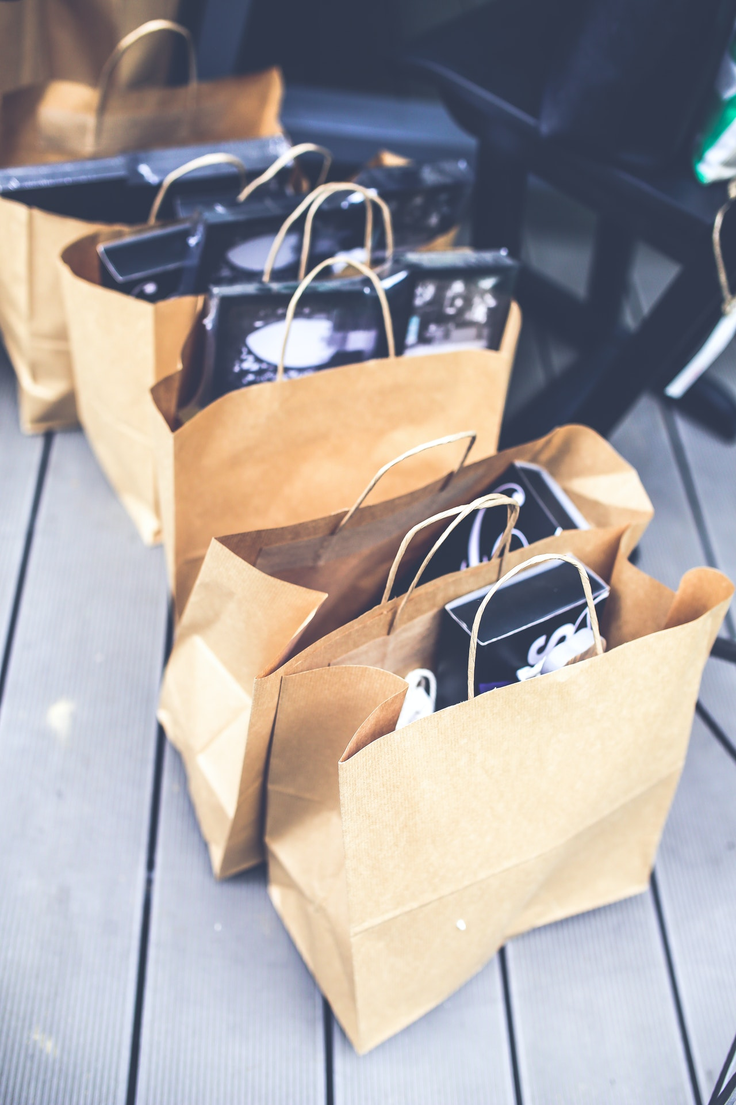
Transport Layer
Or why do we use shopping bags?
Photos courtesy Pexels.com and are subject to the pexels license, https://www.pexels.com/license/c

Slide 20
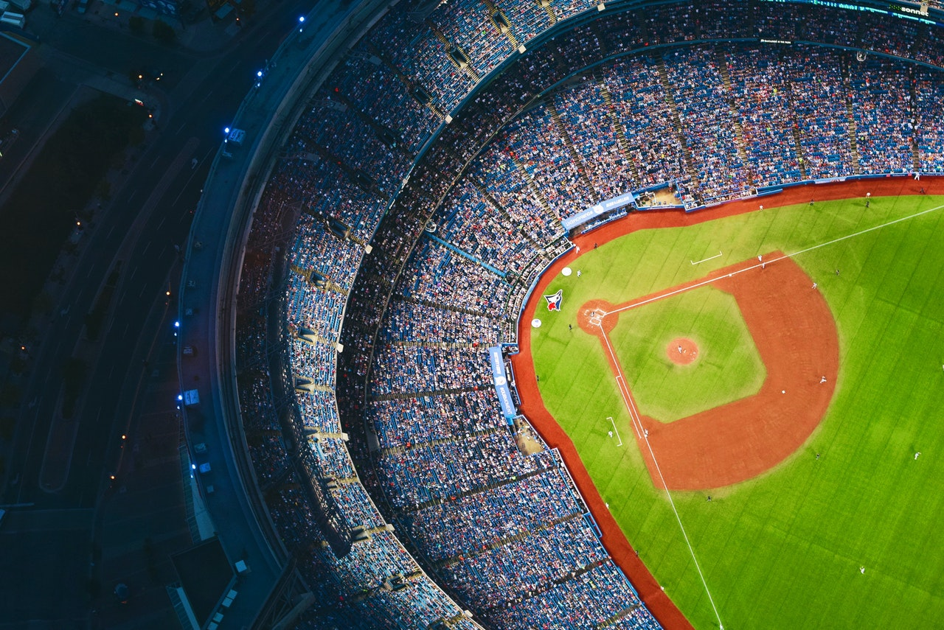
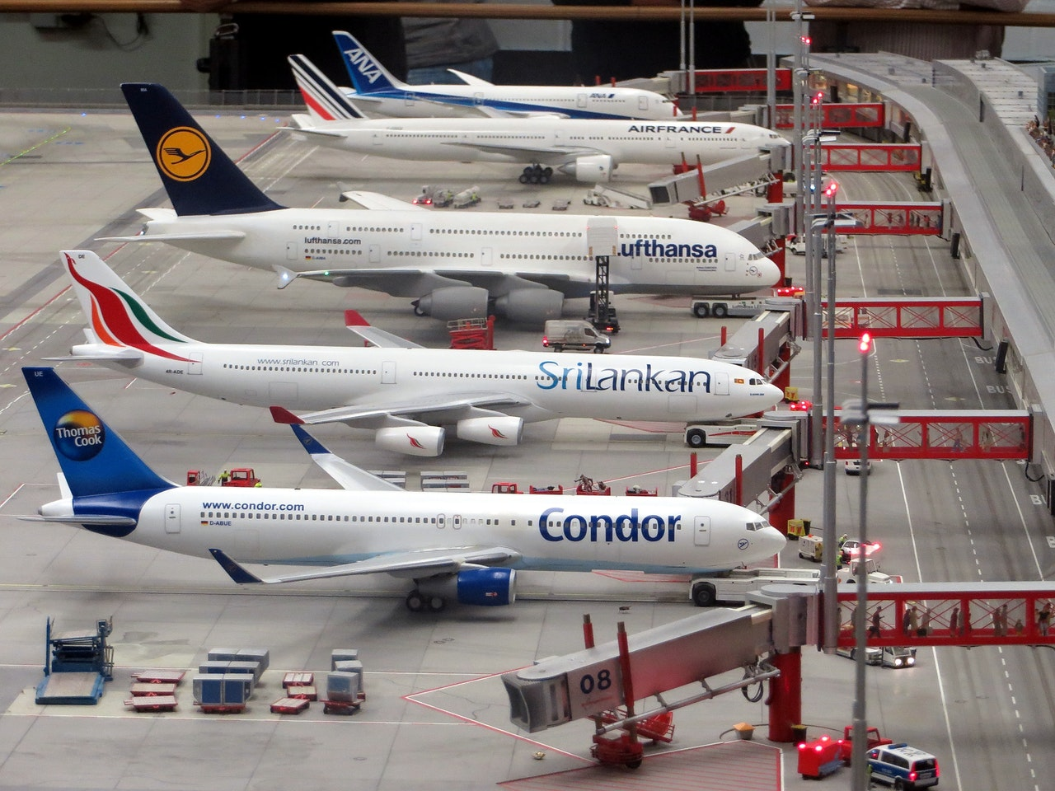
Transport Layer
UDP
Process to Process Communication
TCP
User Datagram Protocol
Connectionless
No Handshake
Unreliable
Stateless
Transmission Control Protocol
Connection-Oriented
Handshake
Reliable
Stateful
Sports Broadcast
Air Tower Coordination
Photos courtesy Pexels.com and are subject to the pexels license, https://www.pexels.com/license/
Biography: Communication Networks, a Tops Down Approach and Wikipedia

